Slide 1
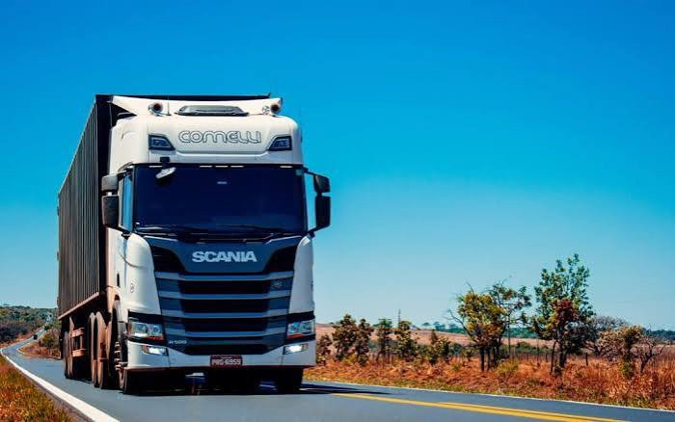
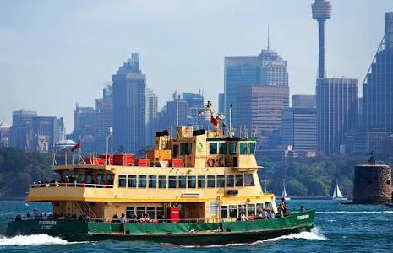
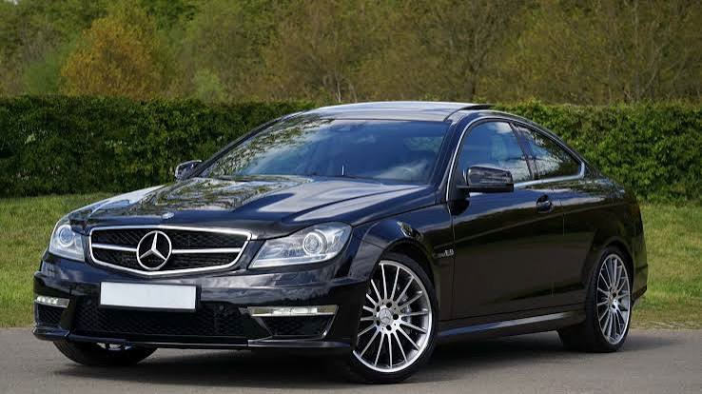
The Transport Book By Huntah Baxter

Slide 2
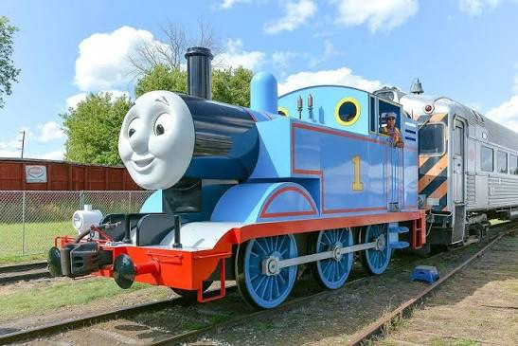
T is for Thomas...
Who is totally terrific

Slide 3
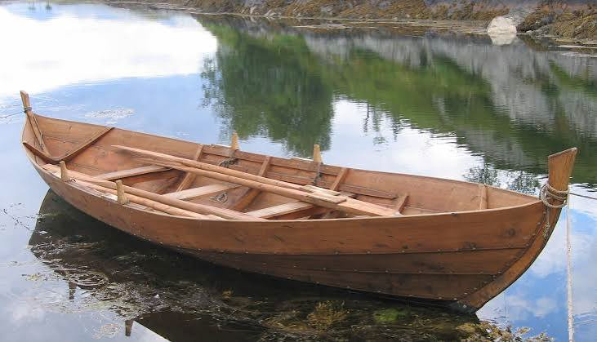
R is for Rowboat...
That is really relaxing

Slide 4
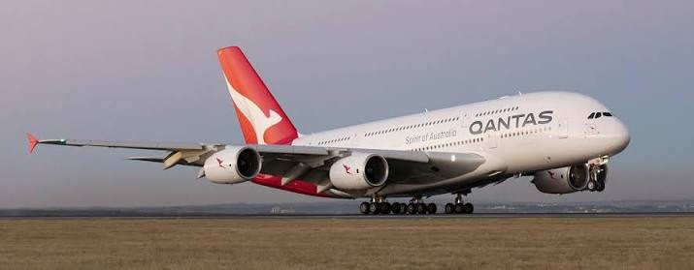
A is for Airplane...
Very active in the sky

Slide 5
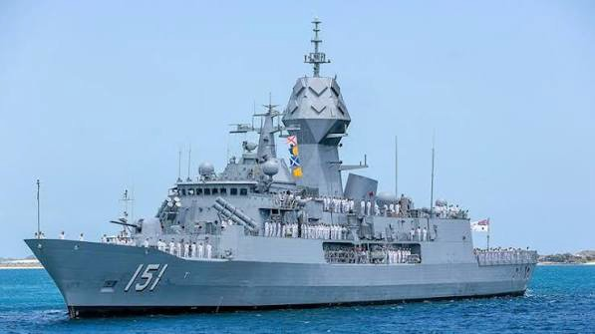
N is for Navy Cruiser...
Navigating the seas

Slide 6
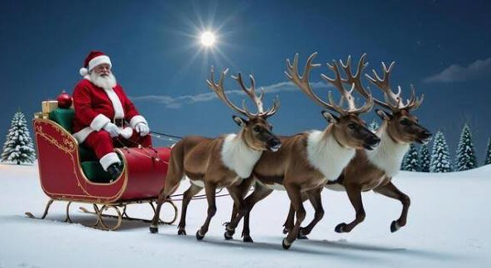
S is for Santa's Sleigh...
Dashing through the snow

Slide 7
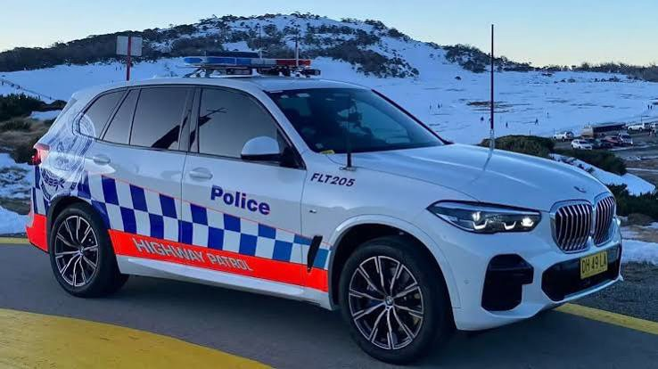
P is for Police Car... protecting the streets

Slide 8
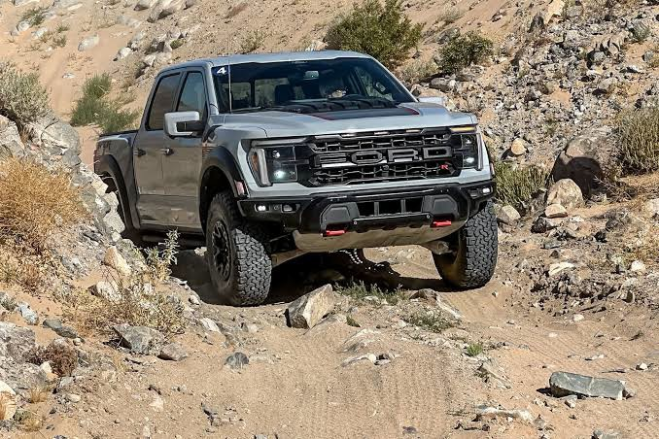
O is for Oﬀ Road vehicle...
Overcoming obstacles

Slide 9
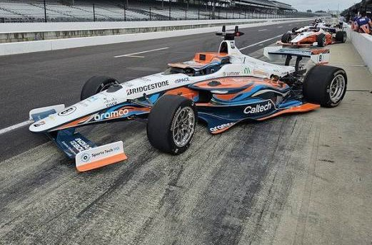
R is for Race car...
Racing around the track

Slide 10
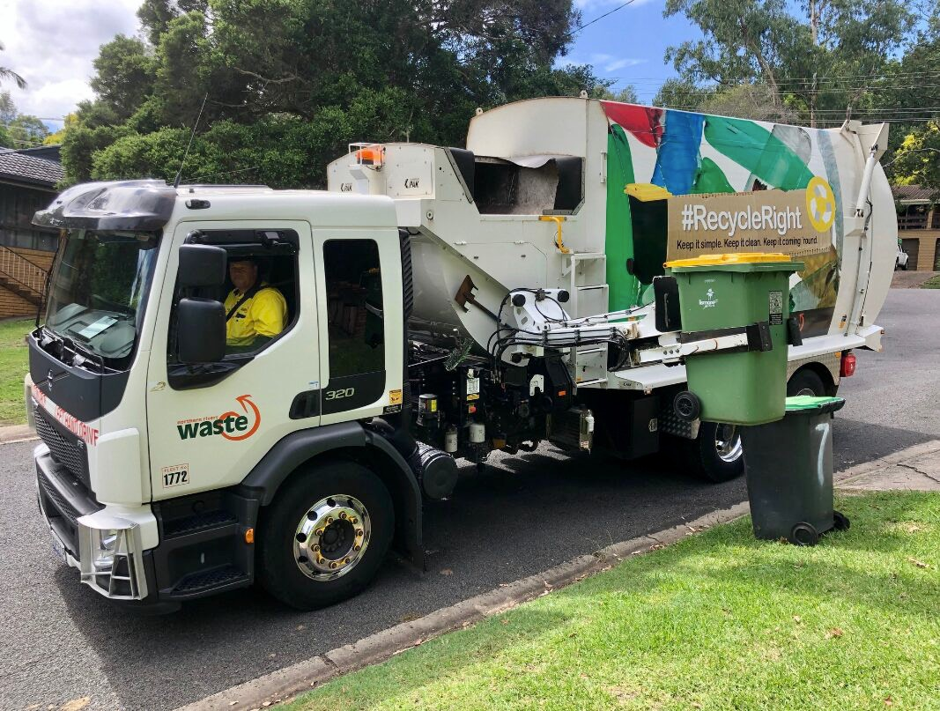
T is for Truck... tooting it's horn

