Slide 1
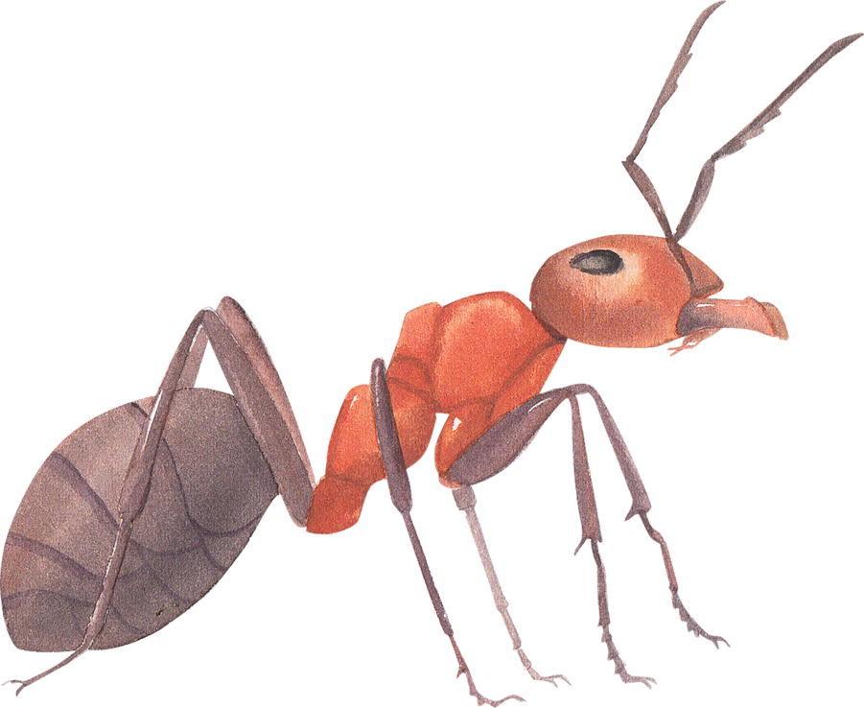
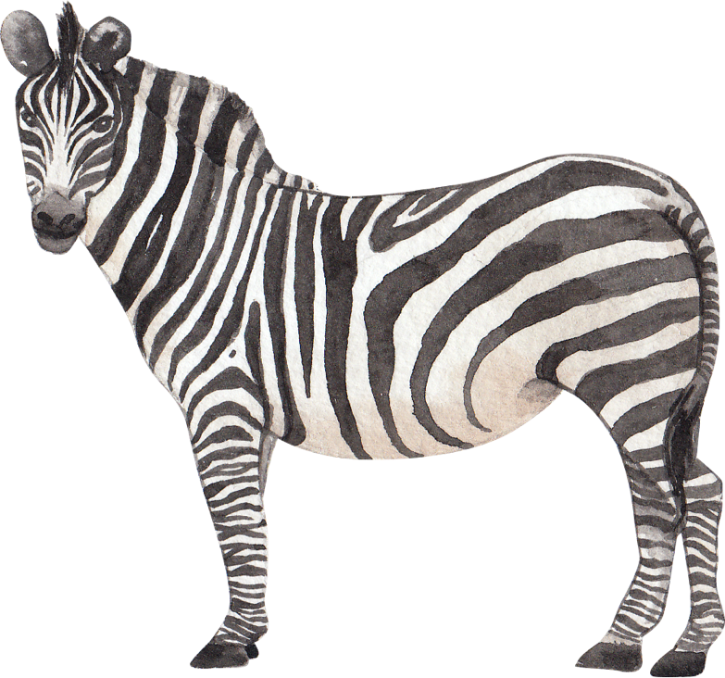

Aa - Zz
Letter Sounds
3rd September 2021

Slide 2

Letter Sounds
This PowerPoint is designed as a guide for letter sounds, to be used by people implementing Explicit Alphabet Knowledge with emergent literacy learner. Click on the speaker icon on each slide to hear the sounds each letter makes.
Please note: different phonics programs list differing numbers of sounds for each letter. I have focused on the most common sounds only in this guide as this is a resource for EAK instruction and not a phonics program.

Slide 3


Aa
has three common sounds:
apple, snake, father
Use the a sound from apple.

Slide 4
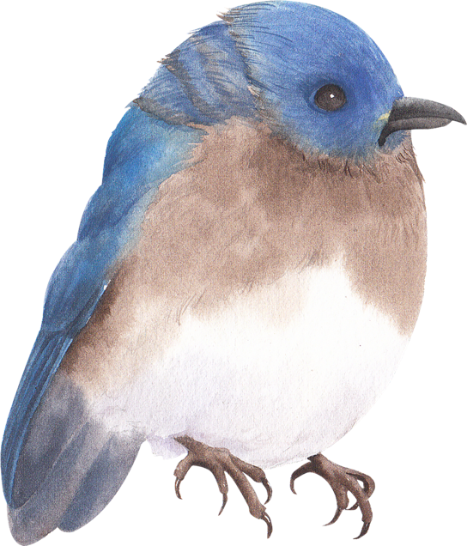
Bb
has one sound:
bird

Slide 5
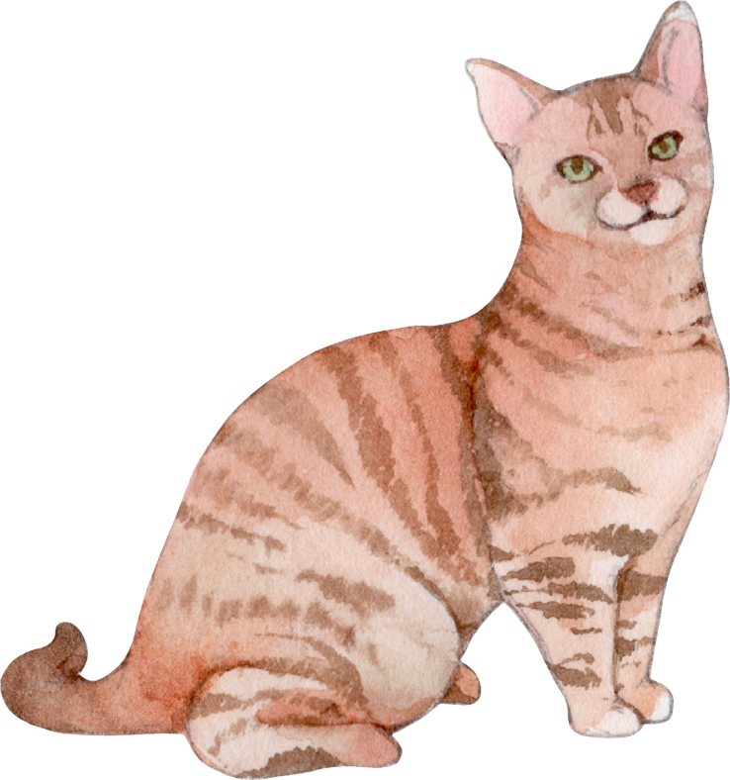
Cc
has two sounds:
cat, circus.
Use the c sound from cat.

Slide 6
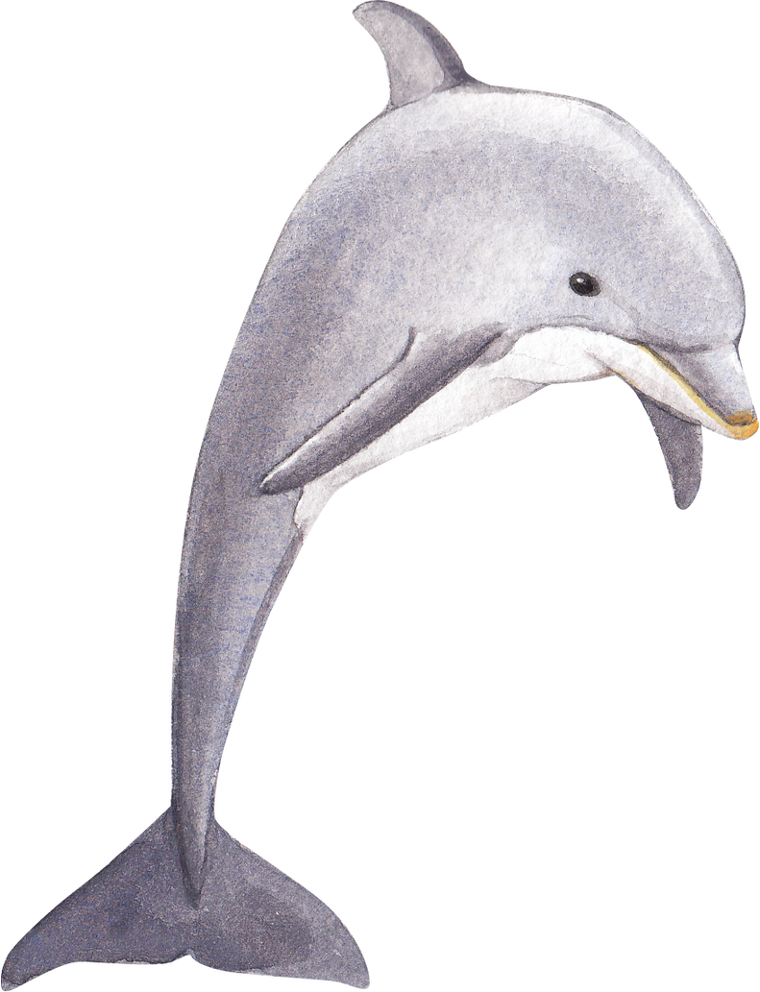
Dd
has one sound:
dolphin

Slide 7

Ee
has three common sounds:
bed, eel, her
Use the e sound from bed.

Slide 8
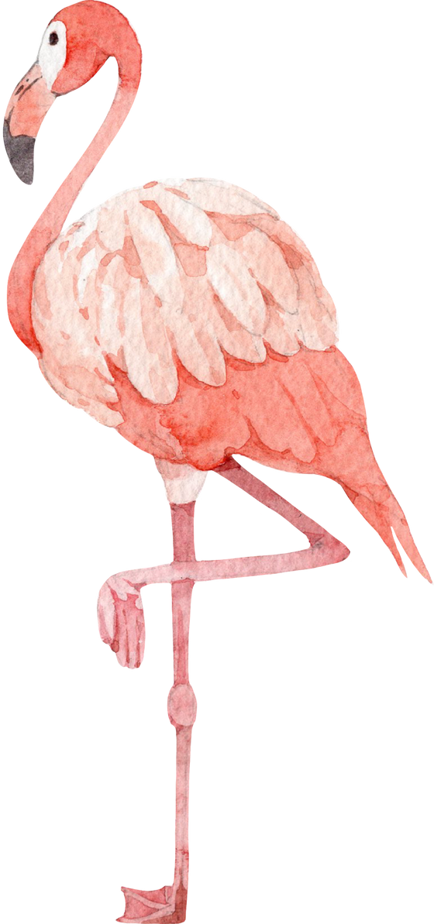
Ff
has one sound:
fight

Slide 9

Gg
has two sounds:
gold, giraffe
Use the g sound from gold.

Slide 10
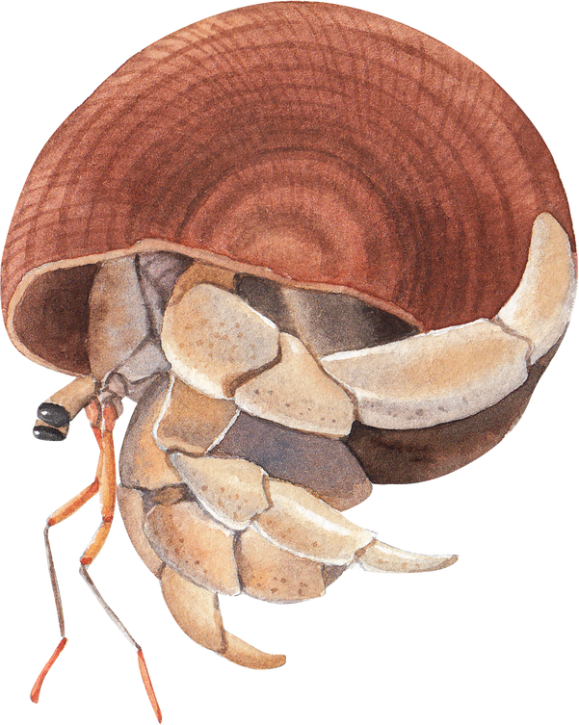
Hh
has one sound:
happy

Slide 11
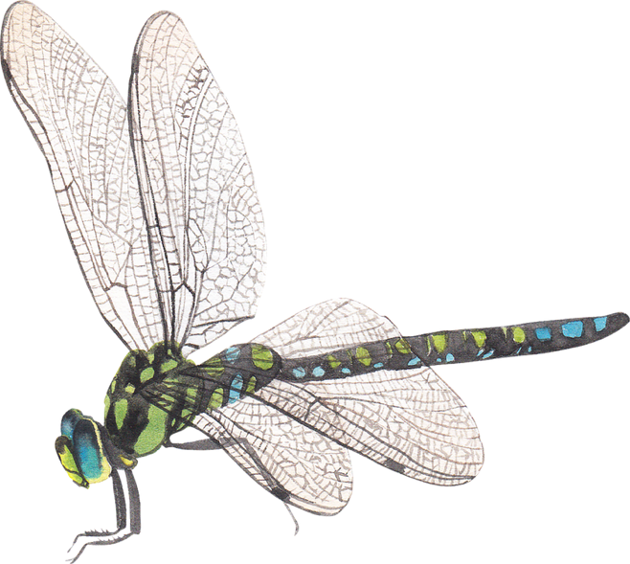
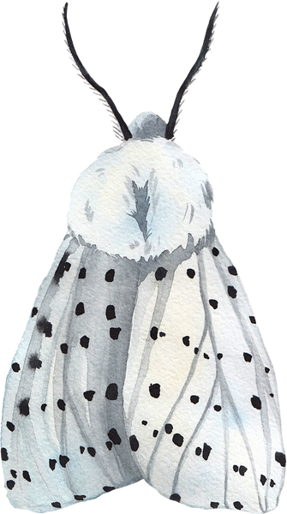
Ii
has three common sounds:
big, ice, ski,
Use the i sound from big.

Slide 12

Jj
has one sound:
jump

Slide 13
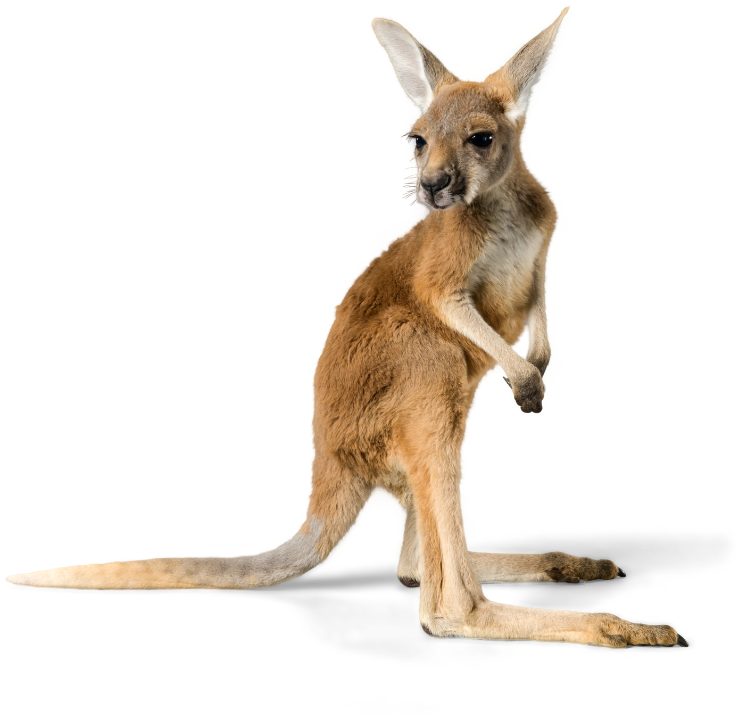
Kk
has one sound:
kid

Slide 14
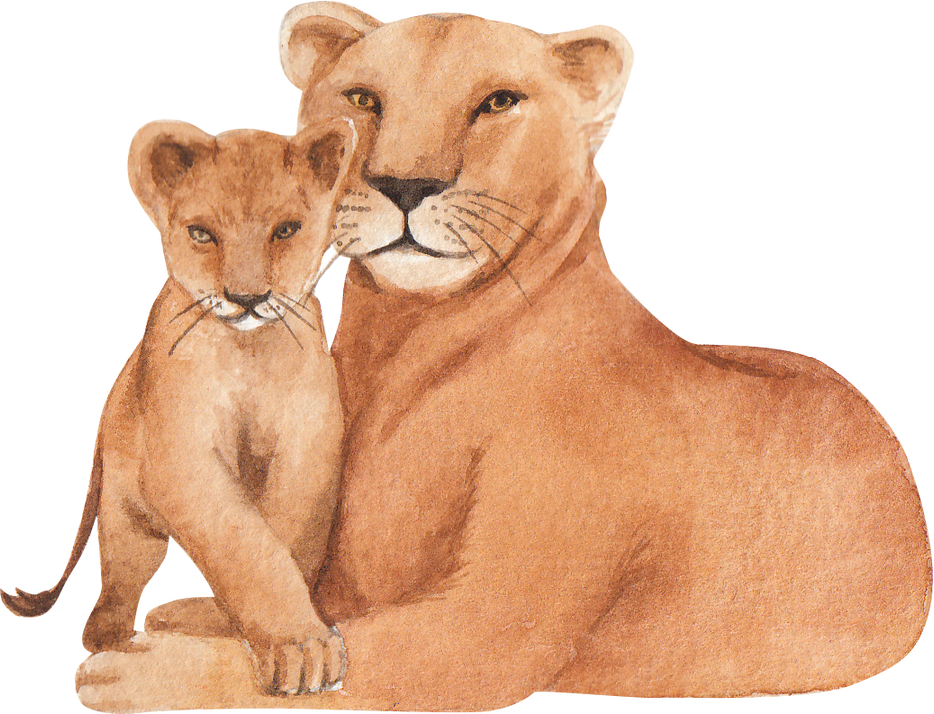
Ll
has one sound:
lion

Slide 15
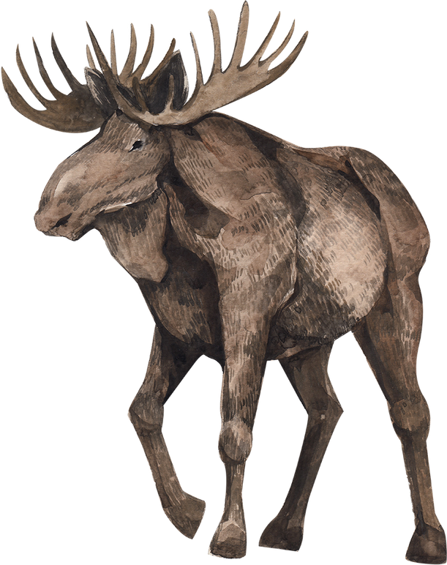
Mm
has one sound:
milk

Slide 16
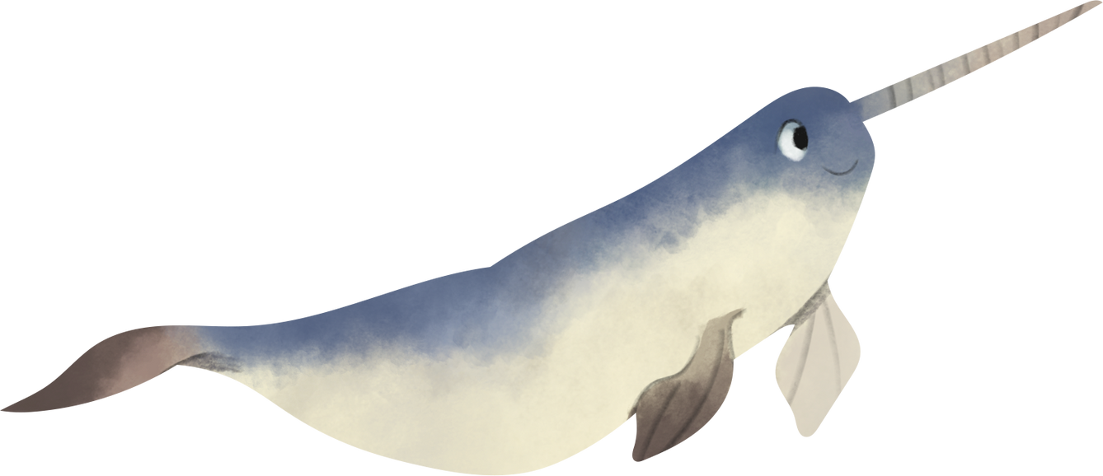
Nn
has one sound:
nose

Slide 17
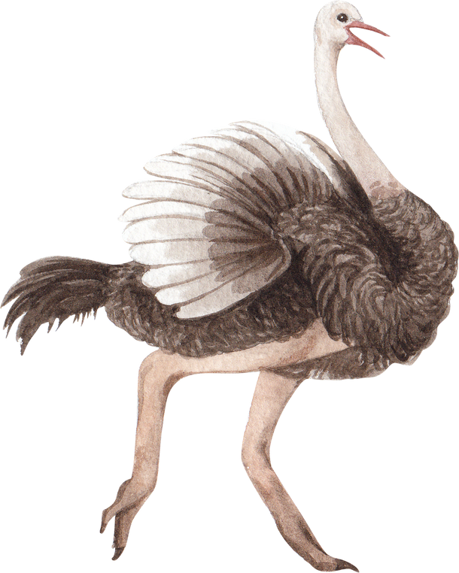
Oo
has three common sounds:
on, toe, son
Use the o sound from on.

Slide 18
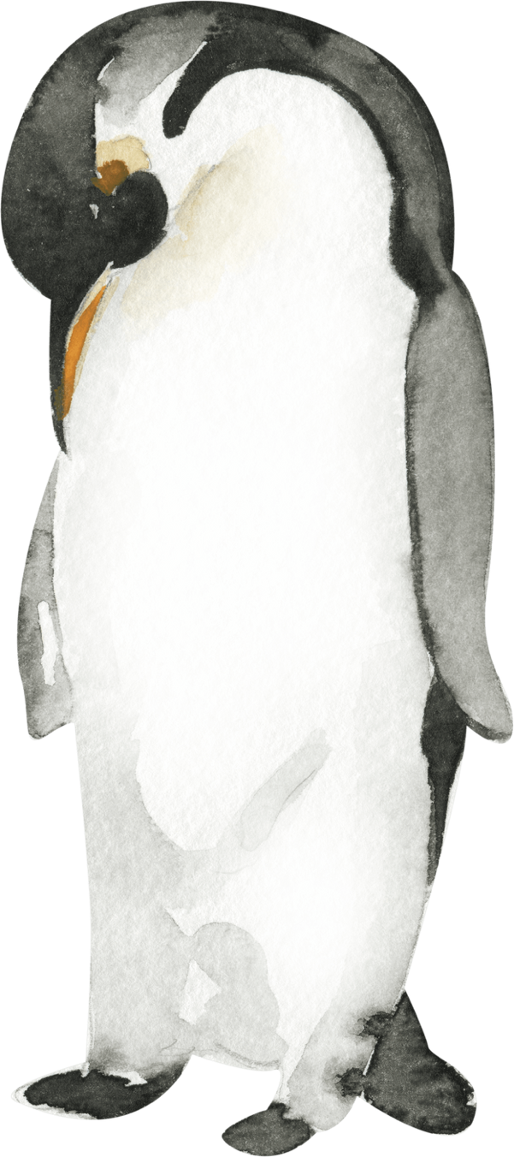
Pp
has one sound:
pot

Slide 19
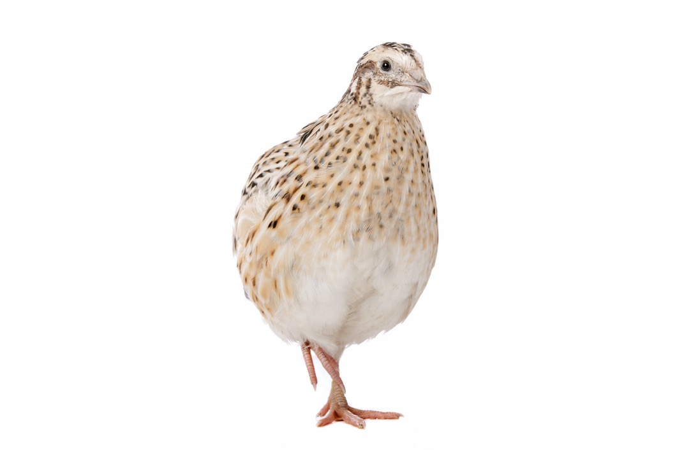
Qq
has one sound:
quick

Slide 20
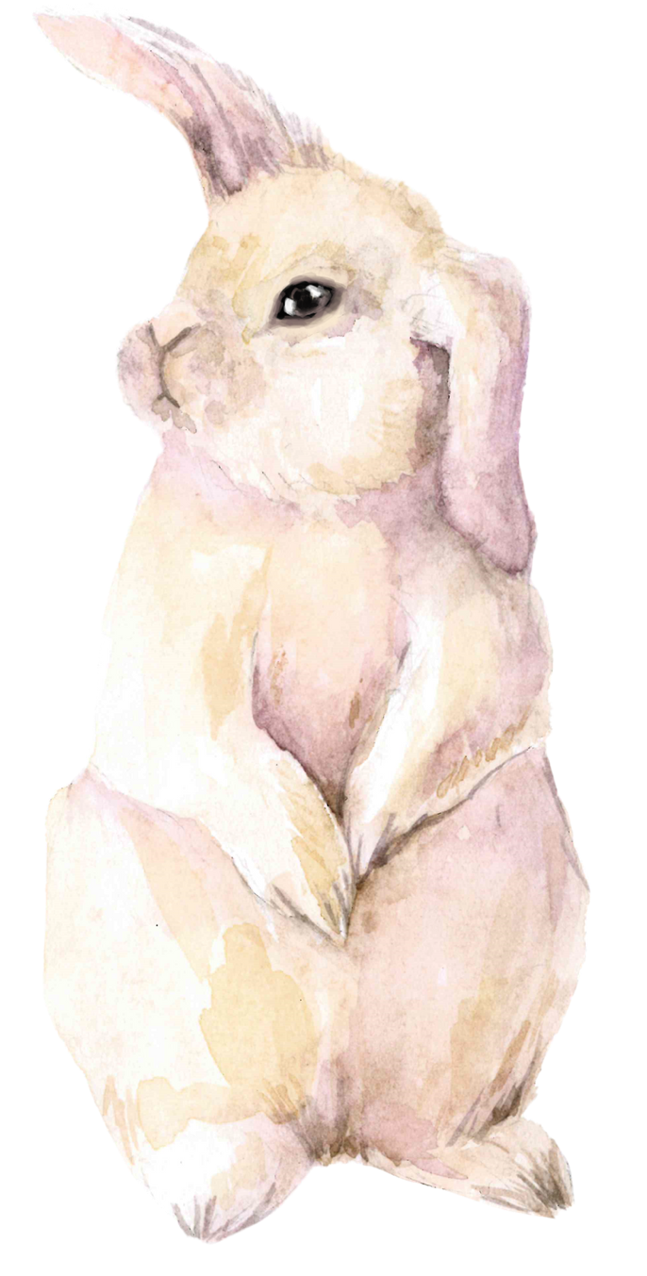
Rr
has one sound:
rabbit

Slide 21
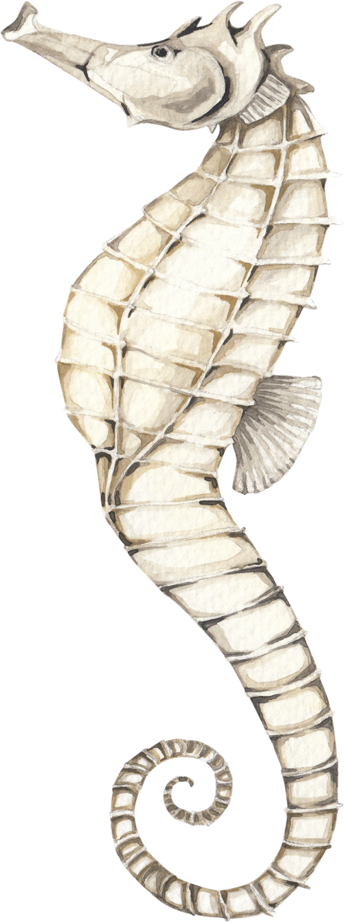
Ss
has two sounds:
sea, was
Use the s sound from sea.

Slide 22
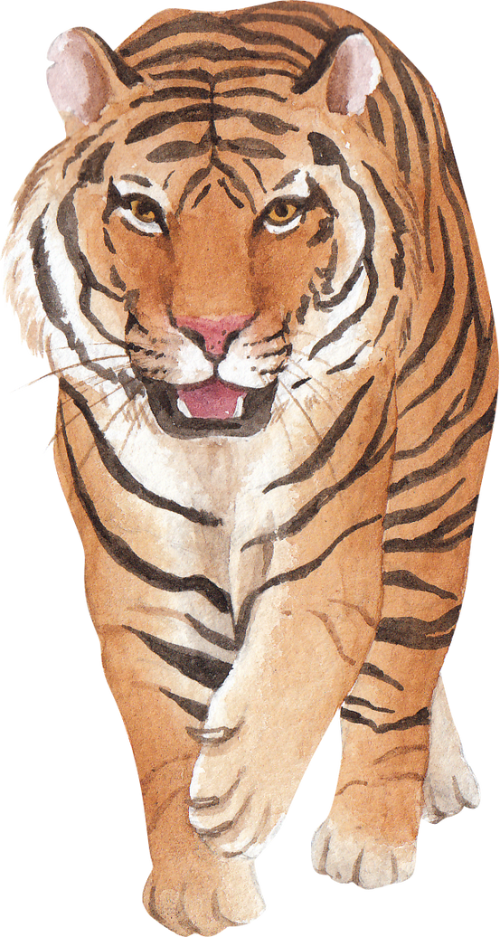
Tt
has one sound:
tiger

Slide 23
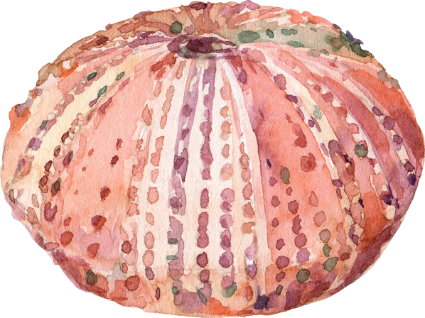
Uu
has three common sounds:
up, due, use
Use the u sound from up.

Slide 24
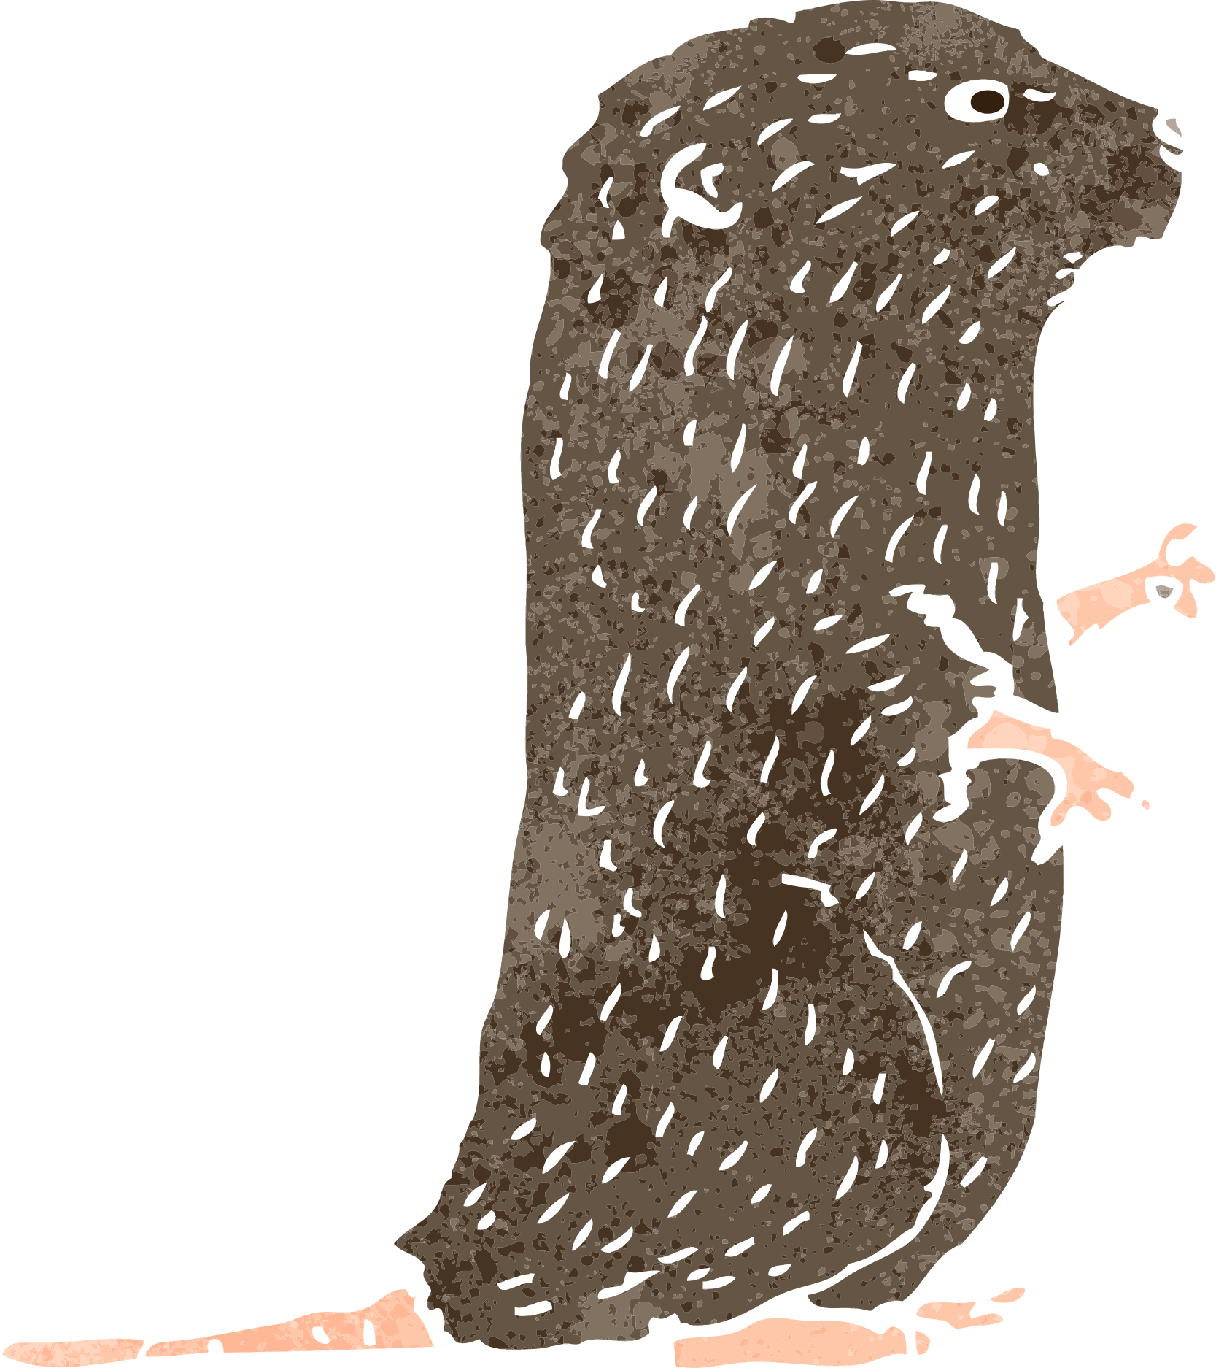
Vv
has one sound:
van

Slide 25
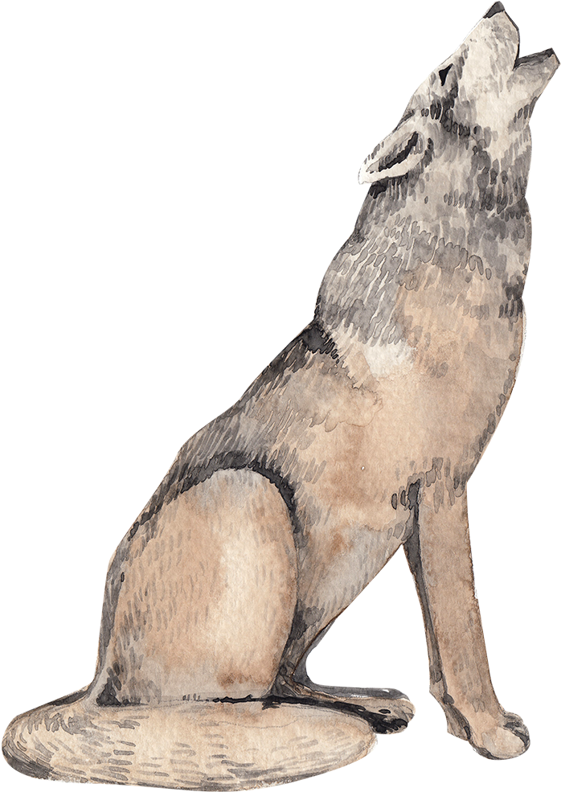
Ww
has one sound:
want

Slide 26
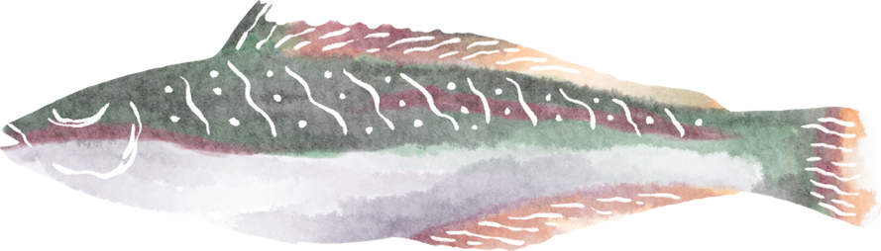
Xx
has two sounds:
wax, xylophone
Use the x sound in wax.

Slide 27
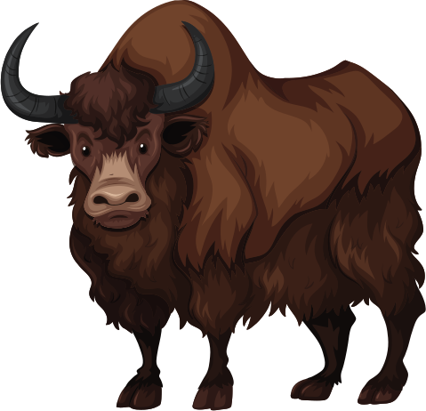
Yy
has one consonant sound and three vowel sounds:
Yak, bye, happy, gym
Use the y sound in yak.

Slide 28
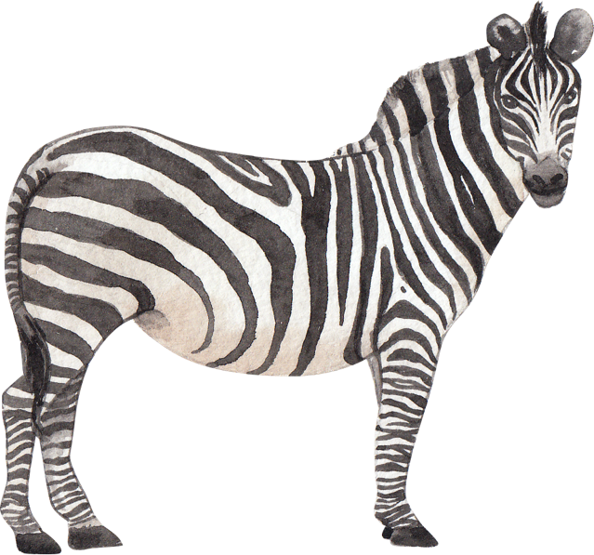
Zz
has two sounds
zoo, pretzel
Use the z sound in zoo.

