Slide 1
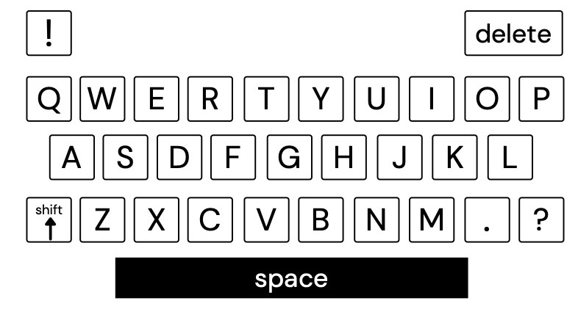
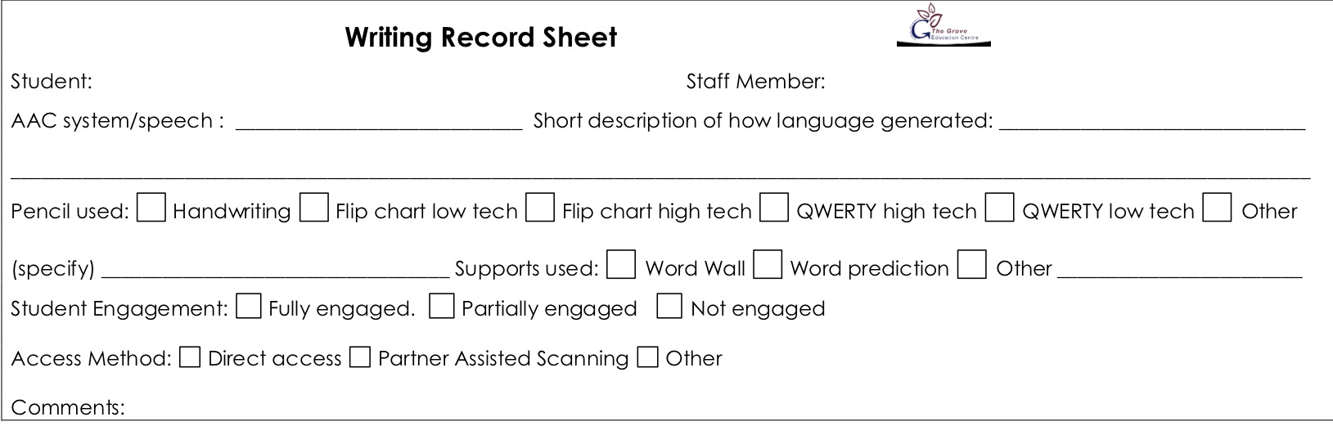
Lesson: Writing from Me– Group H. Day: Monday Students: Levi | Curriculum links and resources | AAC pathways
Learning intention: Students in Group H will write one or more complex sentences with conjunctions and components of who, what, when, where and why. Success criteria: All Students will write one or more complex sentences with conjunctions and two or more components of who, what, when, where and why. Most Students will write one or more complex sentences with conjunctions and three or more components of who, what, when, where and why. Some Students will write two or more complex sentences with conjunctions and four or more components of who, what, when, where and why.. The Grove 5: Safe hands – type on a QWERTY keyboard Safe feet – feet on the floor I am responsible – look after school property Assessment/evidence of learning: Writing record form Writing samples in English book | Australian Curriculum: English: Create short imaginative, informative and persuasive texts using growing knowledge of text structures and language features (ACELY1671) General Capabilities: Literacy: Composing texts SACE: ?? | Proloquo2go Core words: Words appropriate to the interaction including little words Fringe words: Words appropriate to the topic and interaction If the student generates a sentence fragment, make sure you model visually changing it to a complete sentence
Lesson Sequence: Lesson Intro: Teacher will do a mini-lesson modelling one to two complex sentences, with conjunctions and components of the 5Ws. Teacher may “talk aloud” to model generating language and using spaces and may model sounding out words and using word wall. Student will select a topic from a choice of three or more photos/images. Writing guidelines: 1. Ask the student(s) to write one or two complex sentences. They should be using a keyboard most or all of the time, with handwriting optional depending on their motor skills. 2. As students are writing, move around and conference with them. If students struggle with ideas and language, move to them first and use AAC to support them. If students do not know how to spell a word, encourage them to write down every sound they can hear or use the word wall. Do not correct spelling, etc while they are writing. Review: Follow with a short conference about their writing, providing lots of positive feedback, particularly around the area focused on in the mini lesson. | Resources Writing tool –QWERTY keyboard, pen Writing record forms English book Three or more photos/images for topic selection Pen/pencil to transcribe student writing if needed Glue stick to add image and record form to English book | PODD Two Page Opening PODD: Students at this level should be using or getting access to a Two Page Opening PODD book to enable modelling and generation of little words. Alternatively, they should be using the 60 cell arrangement in a PODD app. If the student generates a sentence fragment, make sure you model visually changing it to a complete sentence

Slide 2
Lesson: Writing from Me– Group H. Day: Tuesday Students: Levi | Curriculum links and resources | AAC pathways
Learning intention: Students in Group H will write one or more complex sentences with conjunctions and components of who, what, when, where and why. Success criteria: All Students will write one or more complex sentences with conjunctions and two or more components of who, what, when, where and why. Most Students will write one or more complex sentences with conjunctions and three or more components of who, what, when, where and why. Some Students will write two or more complex sentences with conjunctions and four or more components of who, what, when, where and why.. The Grove 5: Safe hands – type on a QWERTY keyboard Safe feet – feet on the floor I am responsible – look after school property Assessment/evidence of learning: Writing record form Writing samples in English book | Australian Curriculum: English: Create short imaginative, informative and persuasive texts using growing knowledge of text structures and language features (ACELY1671) Science: Objects are made of materials that have observable properties (ACSSU003) General Capabilities: Literacy: Composing texts SACE: ?? | Proloquo2go Core words: Words appropriate to the interaction including little words Fringe words: Words appropriate to the topic and interaction If the student generates a sentence fragment, make sure you model visually changing it to a complete sentence
Lesson Sequence: Lesson Intro: Class will watch a video on density, floating and sinking https://www.youtube.com/watch?v=2dyCe1GPagE. Teacher will do a mini-lesson modelling one to two complex sentences, with conjunctions and components of the 5Ws. Teacher may “talk aloud” to model generating language and using spaces and may model sounding out words and using word wall. Student will select a topic from a choice of three or more stills from video. Writing guidelines: 1. Ask the student(s) to write one or two complex sentences. They should be using a keyboard most or all of the time, with handwriting optional depending on their motor skills. 2. As students are writing, move around and conference with them. If students struggle with ideas and language, move to them first and use AAC to support them. If students do not know how to spell a word, encourage them to write down every sound they can hear or use the word wall. Do not correct spelling, etc while they are writing. Review: Follow with a short conference about their writing, providing lots of positive feedback, particularly around the area focused on in the mini lesson. | Resources Writing tool –QWERTY keyboard, pen Writing record forms English book Three or more photos/images for topic selection Pen/pencil to transcribe student writing if needed Glue stick to add image and record form to English book | PODD Two Page Opening PODD: Students at this level should be using or getting access to a Two Page Opening PODD book to enable modelling and generation of little words. Alternatively, they should be using the 60 cell arrangement in a PODD app. If the student generates a sentence fragment, make sure you model visually changing it to a complete sentence

Slide 3
Lesson: Writing from Me– Group H. Day: Wednesday Students: Levi | Curriculum links and resources | AAC pathways
Learning intention: Students in Group H will write one or more complex sentences with conjunctions and components of who, what, when, where and why. Success criteria: All Students will write one or more complex sentences with conjunctions and two or more components of who, what, when, where and why. Most Students will write one or more complex sentences with conjunctions and three or more components of who, what, when, where and why. Some Students will write two or more complex sentences with conjunctions and four or more components of who, what, when, where and why.. The Grove 5: Safe hands – type on a QWERTY keyboard Safe feet – feet on the floor I am responsible – look after school property Assessment/evidence of learning: Writing record form Writing samples in English book | Australian Curriculum: English: Create short imaginative, informative and persuasive texts using growing knowledge of text structures and language features (ACELY1671) General Capabilities: Literacy: Composing texts SACE: ?? | Proloquo2go Core words: Words appropriate to the interaction including little words Fringe words: Words appropriate to the topic and interaction If the student generates a sentence fragment, make sure you model visually changing it to a complete sentence
Lesson Sequence: Lesson Intro: Teacher will do a mini-lesson modelling one to two complex sentences, with conjunctions and components of the 5Ws. Teacher may “talk aloud” to model generating language and using spaces and may model sounding out words and using word wall. Student will select a topic from a choice of three or more photos/images. Writing guidelines: 1. Ask the student(s) to write one or two complex sentences. They should be using a keyboard most or all of the time, with handwriting optional depending on their motor skills. 2. As students are writing, move around and conference with them. If students struggle with ideas and language, move to them first and use AAC to support them. If students do not know how to spell a word, encourage them to write down every sound they can hear or use the word wall. Do not correct spelling, etc while they are writing. Review: Follow with a short conference about their writing, providing lots of positive feedback, particularly around the area focused on in the mini lesson. | Resources Writing tool –QWERTY keyboard, pen Writing record forms English book Three or more photos/images for topic selection Pen/pencil to transcribe student writing if needed Glue stick to add image and record form to English book | PODD Two Page Opening PODD: Students at this level should be using or getting access to a Two Page Opening PODD book to enable modelling and generation of little words. Alternatively, they should be using the 60 cell arrangement in a PODD app. If the student generates a sentence fragment, make sure you model visually changing it to a complete sentence

Slide 4
Lesson: Writing from Me– Group H. Day: Thursday Students: Levi | Curriculum links and resources | AAC pathways
Learning intention: Students in Group H will write one or more complex sentences with conjunctions and components of who, what, when, where and why. Success criteria: All Students will write one or more complex sentences with conjunctions and two or more components of who, what, when, where and why. Most Students will write one or more complex sentences with conjunctions and three or more components of who, what, when, where and why. Some Students will write two or more complex sentences with conjunctions and four or more components of who, what, when, where and why.. The Grove 5: Safe hands – type on a QWERTY keyboard Safe feet – feet on the floor I am responsible – look after school property Assessment/evidence of learning: Writing record form Writing samples in English book | Australian Curriculum: English: Create short imaginative, informative and persuasive texts using growing knowledge of text structures and language features (ACELY1671) Science: Objects are made of materials that have observable properties (ACSSU003) General Capabilities: Literacy: Composing texts SACE: ?? | Proloquo2go Core words: Words appropriate to the interaction including little words Fringe words: Words appropriate to the topic and interaction If the student generates a sentence fragment, make sure you model visually changing it to a complete sentence
Lesson Sequence: Lesson Intro: Teacher will remind students of the float/sink experiments from the previous day using photos. Teacher will do a mini-lesson modelling one to two complex sentences, with conjunctions and components of the 5Ws. Teacher may “talk aloud” to model generating language and using spaces and may model sounding out words and using word wall. Student will select a topic from a choice of three or more photos/images. Writing guidelines: 1. Ask the student(s) to write one or two complex sentences. They should be using a keyboard most or all of the time, with handwriting optional depending on their motor skills. 2. As students are writing, move around and conference with them. If students struggle with ideas and language, move to them first and use AAC to support them. If students do not know how to spell a word, encourage them to write down every sound they can hear or use the word wall. Do not correct spelling, etc while they are writing. Review: Follow with a short conference about their writing, providing lots of positive feedback, particularly around the area focused on in the mini lesson. | Resources Writing tool –QWERTY keyboard, pen Writing record forms English book Three or more photos/images for topic selection Pen/pencil to transcribe student writing if needed Glue stick to add image and record form to English book | PODD Two Page Opening PODD: Students at this level should be using or getting access to a Two Page Opening PODD book to enable modelling and generation of little words. Alternatively, they should be using the 60 cell arrangement in a PODD app. If the student generates a sentence fragment, make sure you model visually changing it to a complete sentence

Slide 5
Lesson: Writing from Me– Group H. Day: Friday (writing without standards). Students: Levi | Curriculum links and resources | AAC pathways
Learning intention: Students in Group H will write one or more complex sentences with conjunctions and components of who, what, when, where and why. Success criteria: All Students will write one or more complex sentences with conjunctions and two or more components of who, what, when, where and why. Most Students will write one or more complex sentences with conjunctions and three or more components of who, what, when, where and why. Some Students will write two or more complex sentences with conjunctions and four or more components of who, what, when, where and why.. The Grove 5: Safe hands – type on a QWERTY keyboard Safe feet – feet on the floor I am responsible – look after school property Assessment/evidence of learning: Writing record form Writing samples in English book | Australian Curriculum: English: Create short texts (ACELY1651) General Capabilities: Literacy: Composing texts SACE: ?? | Proloquo2go Core words: Words appropriate to the interaction including little words Fringe words: Words appropriate to the topic and interaction
Lesson Sequence: Lesson Intro: Teacher will do a mini-lesson modelling one to two expanded sentences, modelling conjunctions as well if appropriate. Teacher may “talk aloud” to model generating language and using spaces and may model sounding out words and using word wall. Student will select a topic from a choice of three or more photos/images. Writing guidelines: 1. Now say “what would you like to write about this?” Encourage them to write. Use the phrase “tell me more” to encourage more writing 2. Do not assist them with selecting language for writing or with their spelling. Write down any language they generate about the topic and the letters they generate. 3. When they have finished writing ask them to add their name to the writing (and date if feasible). You should add date if student doesn’t. 4. Add any additional appropriate notes to the writing record form. Review: Praise student for a job well done! Do not review writing on this day. | Resources Writing tool –QWERTY keyboard, pen Writing record forms English book Three or more photos/images for topic selection Pen/pencil to transcribe student writing if needed Glue stick to add image and record form to English book | PODD Two Page Opening PODD: Students at this level should be using or getting access to a Two Page Opening PODD book to enable modelling and generation of little words. Alternatively, they should be using the 60 cell arrangement in a PODD app.

