Slide 1
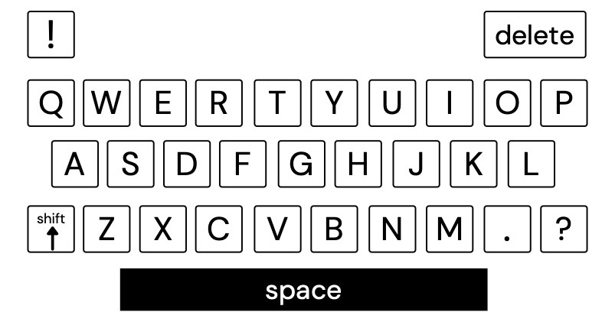
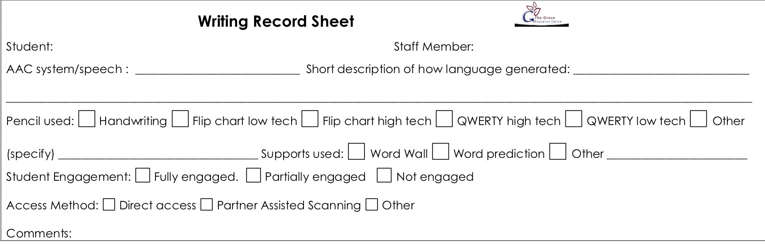
Lesson: Writing from Me– Levels C1 – C4. Day: Monday Students: Alivia | Curriculum links and resources | AAC pathways
Learning intention: Students at Levels C1 – C4 will learn to generate ideas and language on the writing topic Success criteria: All Students will observe modelling on the writing topic. Most Students will co-construct some language on the writing topic. Some Students will select some language related to the writing topic. The Grove 5: Safe hands – select letters from the flip chart or QWERTY keyboard Safe feet – feet on the floor I am responsible – look after school property Assessment/evidence of learning: Writing record form Writing samples in English book | Australian Curriculum: English: Create short texts (ACELY1651) General Capabilities: Literacy: Composing texts SACE: ?? | Proloquo2go Core words: Words appropriate to the interaction Fringe words: Words appropriate to the topic and interaction
Lesson Sequence: Lesson Intro: Student will select a topic from a choice of three or more photos/images Writing guidelines: 1. For students using comprehensive AAC systems – ask them if they have something to say about the photo/activity. If they don‘t, model something you might say, and then ask them if they have something to say again. For verbal students – get them to discuss what they are going to write about it. Agree on something they are writing with the student. 2. Get the student to use a writing tool to select or generate letters. If the student starts typing off the selected topic, remind them of the topic. 3. When they have finished writing, type their originally selected language or the language you suggested and talk about how it relates to the picture. Find something to celebrate in their writing. Review: Step 4 above | Resources Writing tool –QWERTY keyboard Writing record forms English book Three or more photos/images for topic selection Pen/pencil to transcribe student writing Glue stick to add image and record form to English book Topic circle | PODD Chat Words 1a & 1b: Words appropriate to the interaction Pathways: Words appropriate to the topic and interaction

Slide 2
Lesson: Writing from Me– Levels C1 – C4. Day: Tuesday Students: Alivia | Curriculum links and resources | AAC pathways
Learning intention: Students at Levels C1 – C4 will learn to generate ideas and language on the writing topic Success criteria: All Students will observe modelling on the writing topic. Most Students will co-construct some language on the writing topic. Some Students will select some language related to the writing topic. The Grove 5: Safe hands – select letters from the flip chart or QWERTY keyboard Safe feet – feet on the floor I am responsible – look after school property Assessment/evidence of learning: Writing record form Writing samples in English book | Australian Curriculum: English: Create short texts (ACELY1651) Science: Objects are made of materials that have observable properties (ACSSU003) General Capabilities: Literacy: Composing texts SACE: ?? | Proloquo2go Core words: Words appropriate to the interaction Fringe words: Words appropriate to the topic and interaction including up, down, sink, float
Lesson Sequence: Lesson Intro: Class will watch a video on density, floating and sinking https://www.youtube.com/watch?v=2dyCe1GPagE Students will then be offered a choice of stills from the video to write about. Writing guidelines: 1. For students using comprehensive AAC systems – ask them if they have something to say about the photo/activity. If they don‘t, model something you might say, and then ask them if they have something to say again. For verbal students – get them to discuss what they are going to write about it. Agree on something they are writing with the student. 2. Get the student to use a writing tool to select or generate letters. If the student starts typing off the selected topic, remind them of the topic. 3. When they have finished writing, type their originally selected language or the language you suggested and talk about how it relates to the picture. Find something to celebrate in their writing. Review: Step 4 above | Resources Writing tool –QWERTY keyboard Writing record forms English book Three or more photos/images for topic selection Pen/pencil to transcribe student writing Glue stick to add image and record form to English book Topic circle | PODD Chat Words 1a & 1b: Words appropriate to the interaction Pathways: Words appropriate to the topic and interaction More to say > I’m telling you something > actions > turn the page > on/under

Slide 3
Lesson: Writing from Me– Levels C1 – C4. Day: Wednesday Students: Alivia | Curriculum links and resources | AAC pathways
Learning intention: Students at Levels C1 – C4 will learn to generate ideas and language on the writing topic Success criteria: All Students will observe modelling on the writing topic. Most Students will co-construct some language on the writing topic. Some Students will select some language related to the writing topic. The Grove 5: Safe hands – select letters from the flip chart or QWERTY keyboard Safe feet – feet on the floor I am responsible – look after school property Assessment/evidence of learning: Writing record form Writing samples in English book | Australian Curriculum: English: Create short texts (ACELY1651) General Capabilities: Literacy: Composing texts SACE: ?? | Proloquo2go Core words: Words appropriate to the interaction Fringe words: Words appropriate to the topic and interaction
Lesson Sequence: Lesson Intro: Student will select a topic from a choice of three or more photos/images Writing guidelines: 1. For students using comprehensive AAC systems – ask them if they have something to say about the photo/activity. If they don‘t, model something you might say, and then ask them if they have something to say again. For verbal students – get them to discuss what they are going to write about it. Agree on something they are writing with the student. 2. Get the student to use a writing tool to select or generate letters. If the student starts typing off the selected topic, remind them of the topic. 3. When they have finished writing, type their originally selected language or the language you suggested and talk about how it relates to the picture. Find something to celebrate in their writing. Review: Step 4 above | Resources Writing tool –QWERTY keyboard Writing record forms English book Three or more photos/images for topic selection Pen/pencil to transcribe student writing Glue stick to add image and record form to English book Topic circle | PODD Chat Words 1a & 1b: Words appropriate to the interaction Pathways: Words appropriate to the topic and interaction

Slide 4
Lesson: Writing from Me– Levels C1 – C4. Day: Thursday Students: Alivia | Curriculum links and resources | AAC pathways
Learning intention: Students at Levels C1 – C4 will learn to generate ideas and language on the writing topic Success criteria: All Students will observe modelling on the writing topic. Most Students will co-construct some language on the writing topic. Some Students will select some language related to the writing topic. The Grove 5: Safe hands – select letters from the flip chart or QWERTY keyboard Safe feet – feet on the floor I am responsible – look after school property Assessment/evidence of learning: Writing record form Writing samples in English book | Australian Curriculum: English: Create short texts (ACELY1651) Science: Objects are made of materials that have observable properties (ACSSU003) General Capabilities: Literacy: Composing texts SACE: ?? | Proloquo2go Core words: Words appropriate to the interaction Fringe words: Words appropriate to the topic and interaction including up, down, sink, float
Lesson Sequence: Lesson Intro: Teacher will remind students of the float/sink experiments from the previous day using photos. Student will select a photo to write about from a choice of three or more photos/images Writing guidelines: 1. For students using comprehensive AAC systems – ask them if they have something to say about the photo/activity. If they don‘t, model something you might say, and then ask them if they have something to say again. For verbal students – get them to discuss what they are going to write about it. Agree on something they are writing with the student. 2. Get the student to use a writing tool to select or generate letters. If the student starts typing off the selected topic, remind them of the topic. 3. When they have finished writing, type their originally selected language or the language you suggested and talk about how it relates to the picture. Find something to celebrate in their writing. Review: Step 4 above | Resources Writing tool –QWERTY keyboard Writing record forms English book Three or more photos/images for topic selection Pen/pencil to transcribe student writing Glue stick to add image and record form to English book Topic circle | PODD Chat Words 1a & 1b: Words appropriate to the interaction Pathways: Words appropriate to the topic and interaction More to say > I’m telling you something > actions > turn the page > on/under

Slide 5
Lesson: Writing from Me– Levels C1 –C4. Day: Friday (writing without standards) Students: Alivia | Curriculum links and resources | AAC pathways
Learning intention: Students at Levels C1 – C4 will learn to generate ideas and language on the writing topic Success criteria: All Students will observe modelling on the writing topic. Most Students will co-construct some language on the writing topic. Some Students will select some language related to the writing topic. The Grove 5: Safe hands – select letters from the flip chart or QWERTY keyboard Safe feet – feet on the floor I am responsible – look after school property Assessment/evidence of learning: Writing record form Writing samples in English book | Australian Curriculum: English: Create short texts (ACELY1651) General Capabilities: Literacy: Composing texts SACE: ?? | Proloquo2go Core words: Words appropriate to the interaction Fringe words: Words appropriate to the topic and interaction
Lesson Sequence: Lesson Intro: Student will select a topic from a choice of three or more photos/images Writing guidelines: 1. Now say “what would you like to write about this?” Encourage them to write. Use the phrase “tell me more” to encourage more writing 2. Do not assist them with selecting language for writing or with their spelling. Write down any language they generate about the topic and the letters they generate. 3. When they have finished writing ask them to add their name to the writing (and date if feasible). You should add date if student doesn’t. 4. Add any additional appropriate notes to the writing record form. Review: Praise student for a job well done! Do not review writing on this day. | Resources Writing tool – QWERTY keyboard Writing record forms English book Three or more photos/images for topic selection Pen/pencil to transcribe student writing Glue stick to add image and record form to English book Topic circle | PODD Chat Words 1a & 1b: Words appropriate to the interaction Pathways: Words appropriate to the topic and interaction

