Slide 1

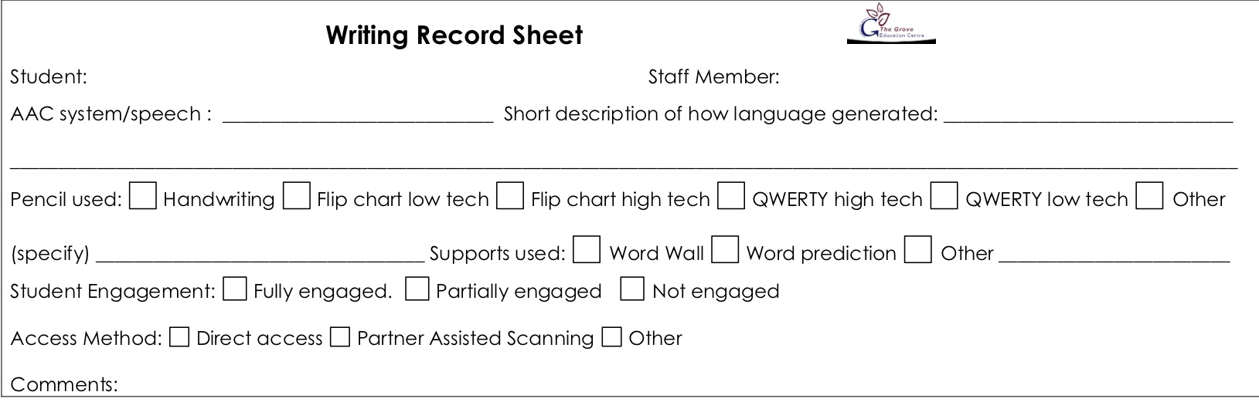
Lesson: Writing from Me– Levels A4 – A6. Day: Monday Students: Madiaba | Curriculum links and resources | AAC pathways
Learning intention: Students at Levels A4 – A6 will develop an understanding that we write with letters and spaces Students at Levels A4 – A6 will begin to attribute meaning to their writing, usually single words Success criteria: All Students will select letters with engagement. Most Students will select letters and spaces with engagement. Some students will select letters and spaces with engagement and attribute meaning. The Grove 5: Safe hands – select letters from the flip chart or QWERTY keyboard Safe feet – feet on the floor I am responsible – look after school property Assessment/evidence of learning: Writing record form Writing samples in English book | Australian Curriculum: English: Create short texts (ACELY1651) General Capabilities: Literacy: Composing texts SACE: ?? | Proloquo2go Core words: Words appropriate to the interaction Fringe words: Words appropriate to the topic and interaction
Lesson Sequence: Lesson Intro: Student will select a topic from a choice of three or more photos/images Writing guidelines: 1. Adult uses AAC to talk about the topic 2. Ask student to generate some language about the topic. If needed, co-construct this language by navigating to an appropriate page in their AAC system. Agree on something they are writing with the student. If you don't get any language selected or generated then move onto the next step. 3. Get the student to use the flip chart, or other writing tool, to select letters. Make sure their tool has a "space" button. Record or write down the letters as they choose them 4. Write their target language (or the meaning you are attributing) under their writing and point out any correlations, using a phrase like "now let me show you how I would write it..." Review: Step 4 above | Resources Writing tool – flip chart Writing record forms English book Three or more photos/images for topic selection Pen/pencil to transcribe student writing Glue stick to add image and record form to English book | PODD Chat Words 1a & 1b: Words appropriate to the interaction Pathways: Words appropriate to the topic and interaction

Slide 2
Lesson: Writing from Me– Levels A4 – A6. Day: Tuesday Students: Madiaba | Curriculum links and resources | AAC pathways
Learning intention: Students at Levels A4 – A6 will develop an understanding that we write with letters and spaces Students at Levels A4 – A6 will begin to attribute meaning to their writing, usually single words Success criteria: All Students will select letters with engagement. Most Students will select letters and spaces with engagement. Some students will select letters and spaces with engagement and attribute meaning. The Grove 5: Safe hands – select letters from the flip chart or QWERTY keyboard Safe feet – feet on the floor I am responsible – look after school property Assessment/evidence of learning: Writing record form Writing samples in English book | Australian Curriculum: English: Create short texts (ACELY1651) Science: Objects are made of materials that have observable properties (ACSSU003) General Capabilities: Literacy: Composing texts SACE: ?? | Proloquo2go Core words: Words appropriate to the interaction Fringe words: Words appropriate to the topic and interaction including up, down, sink, float
Lesson Sequence: Lesson Intro: Class will watch a video on density, floating and sinkin https://www.youtube.com/watch?v=2dyCe1GPagE Students will then be offered a choice of stills from the video to write about. Writing guidelines: 1. Adult uses AAC to talk about the topic 2. Ask student to generate some language about the topic. If needed, co-construct this language by navigating to an appropriate page in their AAC system. Agree on something they are writing with the student. If you don't get any language selected or generated then move onto the next step. 3. Get the student to use the flip chart, or other writing tool, to select letters. Make sure their tool has a "space" button. Record or write down the letters as they choose them 4. Write their target language (or the meaning you are attributing) under their writing and point out any correlations, using a phrase like "now let me show you how I would write it..." Review: Step 4 above | Resources Writing tool – flip chart Writing record forms English book Three or more photos/images for topic selection Pen/pencil to transcribe student writing Glue stick to add image and record form to English book | PODD Chat Words 1a & 1b: Words appropriate to the interaction Pathways: Words appropriate to the topic and interaction More to say > I’m telling you something > actions > turn the page > on/under

Slide 3
Lesson: Writing from Me– Levels A4 – A6. Day: Wednesday Students: Madiaba | Curriculum links and resources | AAC pathways
Learning intention: Students at Levels A4 – A6 will develop an understanding that we write with letters and spaces Students at Levels A4 – A6 will begin to attribute meaning to their writing, usually single words Success criteria: All Students will select letters with engagement. Most Students will select letters and spaces with engagement. Some students will select letters and spaces with engagement and attribute meaning. The Grove 5: Safe hands – select letters from the flip chart or QWERTY keyboard Safe feet – feet on the floor I am responsible – look after school property Assessment/evidence of learning: Writing record form Writing samples in English book | Australian Curriculum: English: Create short texts (ACELY1651) General Capabilities: Literacy: Composing texts SACE: ?? | Proloquo2go Core words: Words appropriate to the interaction Fringe words: Words appropriate to the topic and interaction
Lesson Sequence: Lesson Intro: Student will select a topic from a choice of three or more photos/images Writing guidelines: 1. Adult uses AAC to talk about the topic 2. Ask student to generate some language about the topic. If needed, co-construct this language by navigating to an appropriate page in their AAC system. Agree on something they are writing with the student. If you don't get any language selected or generated then move onto the next step. 3. Get the student to use the flip chart, or other writing tool, to select letters. Make sure their tool has a "space" button. Record or write down the letters as they choose them 4. Write their target language (or the meaning you are attributing) under their writing and point out any correlations, using a phrase like "now let me show you how I would write it..." Review: Step 4 above | Resources Writing tool – flip chart Writing record forms English book Three or more photos/images for topic selection Pen/pencil to transcribe student writing Glue stick to add image and record form to English book | PODD Chat Words 1a & 1b: Words appropriate to the interaction Pathways: Words appropriate to the topic and interaction

Slide 4
Lesson: Writing from Me– Levels A4 – A6. Day: Thursday Students: Madiaba | Curriculum links and resources | AAC pathways
Learning intention: Students at Levels A4 – A6 will develop an understanding that we write with letters and spaces Students at Levels A4 – A6 will begin to attribute meaning to their writing, usually single words Success criteria: All Students will select letters with engagement. Most Students will select letters and spaces with engagement. Some students will select letters and spaces with engagement and attribute meaning. The Grove 5: Safe hands – select letters from the flip chart or QWERTY keyboard Safe feet – feet on the floor I am responsible – look after school property Assessment/evidence of learning: Writing record form Writing samples in English book | Australian Curriculum: English: Create short texts (ACELY1651) Science: Objects are made of materials that have observable properties (ACSSU003) General Capabilities: Literacy: Composing texts SACE: ?? | Proloquo2go Core words: Words appropriate to the interaction Fringe words: Words appropriate to the topic and interaction including up, down, sink, float
Lesson Sequence: Lesson Intro: Teacher will remind students of the float/sink experiments from the previous day using photos. Student will select a photo to write about from a choice of three or more photos/images Writing guidelines: 1. Adult uses AAC to talk about the topic 2. Ask student to generate some language about the topic. If needed, co-construct this language by navigating to an appropriate page in their AAC system. Agree on something they are writing with the student. If you don't get any language selected or generated then move onto the next step. 3. Get the student to use the flip chart, or other writing tool, to select letters. Make sure their tool has a "space" button. Record or write down the letters as they choose them 4. Write their target language (or the meaning you are attributing) under their writing and point out any correlations, using a phrase like "now let me show you how I would write it..." Review: Step 4 above | Resources Writing tool – flip chart Writing record forms English book Three or more photos/images for topic selection Pen/pencil to transcribe student writing Glue stick to add image and record form to English book | PODD Chat Words 1a & 1b: Words appropriate to the interaction Pathways: Words appropriate to the topic and interaction More to say > I’m telling you something > actions > turn the page > on/under

Slide 5
Lesson: Writing from Me– Levels A4 – A6. Day: Friday (writing without standards) Students: Madiaba | Curriculum links and resources | AAC pathways
Learning intention: Students at Levels A4 – A6 will develop an understanding that we write with letters and spaces Students at Levels A4 – A6 will begin to attribute meaning to their writing, usually single words Success criteria: All Students will select letters with engagement. Most Students will select letters and spaces with engagement. Some students will select letters and spaces with engagement and attribute meaning. The Grove 5: Safe hands – select letters from the flip chart or QWERTY keyboard Safe feet – feet on the floor I am responsible – look after school property Assessment/evidence of learning: Writing record form Writing samples in English book | Australian Curriculum: English: Create short texts (ACELY1651) General Capabilities: Literacy: Composing texts SACE: ?? | Proloquo2go Core words: Words appropriate to the interaction Fringe words: Words appropriate to the topic and interaction
Lesson Sequence: Lesson Intro: Student will select a topic from a choice of three or more photos/images Writing guidelines: 1. Now say “what would you like to write about this?” Encourage them to write. Use the phrase “tell me more” to encourage more writing 2. Do not assist them with selecting language for writing or with their spelling. Write down any language they generate about the topic and the letters they generate. 3. When they have finished writing ask them to add their name to the writing (and date if feasible). You should add date if student doesn’t. 4. Add any additional appropriate notes to the writing record form. Review: Praise student for a job well done! Do not review writing on this day. | Resources Writing tool – flip chart Writing record forms English book Three or more photos/images for topic selection Pen/pencil to transcribe student writing Glue stick to add image and record form to English book | PODD Chat Words 1a & 1b: Words appropriate to the interaction Pathways: Words appropriate to the topic and interaction

