Slide 1

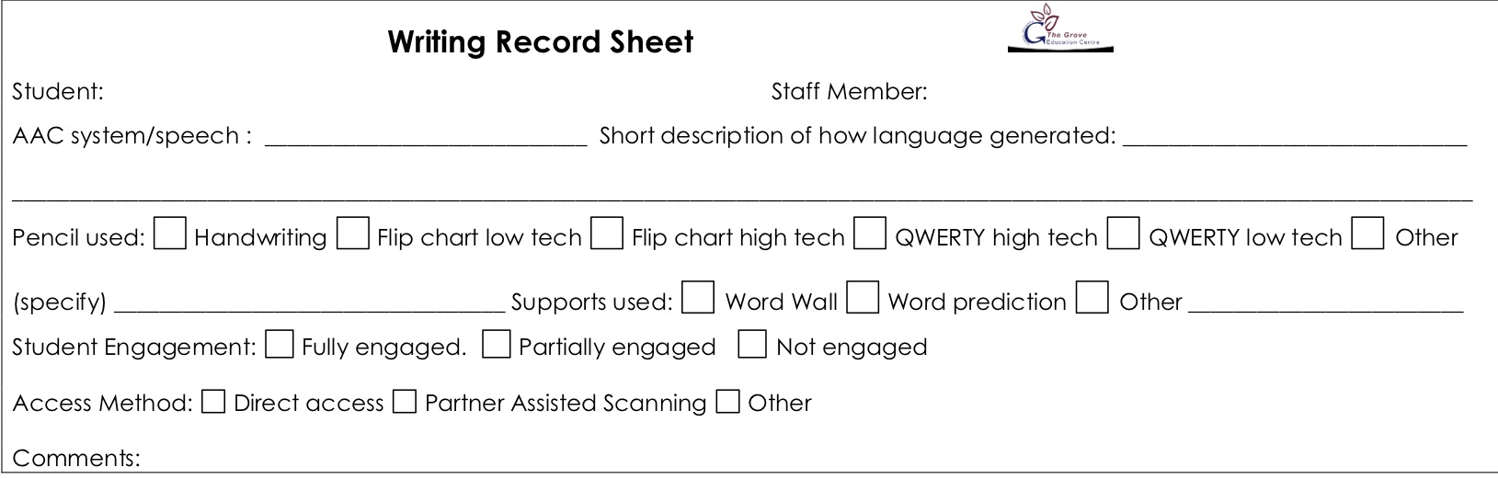
Lesson: Writing from Me– Levels A1 – A3. Day: Monday Students: Saran | Curriculum links and resources | AAC pathways
Learning intention: Students at Levels A1 – A3 will develop an understanding that they are a writer Students at Levels A1 – A3 will develop increased engagement and interest in the writing process Students at Levels A1 - A3 will develop increased attention to the writing output Students at Levels A1 – A3 will develop an understanding that we write with letters Success criteria: All Students will select letters or make marks. Most Students will select letters or make marks with beginning engagement. Some students will select letters with active attention. The Grove 5: Safe hands – select letters from the flip chart or sensory pencil Safe feet – feet on the floor I am responsible – look after school property Assessment/evidence of learning: Writing record form Writing samples in English book | Australian Curriculum: English: Create short texts (ACELY1651) General Capabilities: Literacy: Composing texts SACE: ?? | Proloquo2go Core words: focus on core words on the home page of Proloquo2Go for students at this level,
Lesson Sequence: Lesson Intro: To set the topic, student should have just participated in an activity that they enjoy. Writing guidelines: 1. Use AAC to talk briefly about the topic – the activity or game that the student has just engaged with. 2. Get the student to use a writing tool (sensory pencil or flip chart) to select letters; record or write down the letters as they choose them. 3. Use the student‘s AAC system to attribute meaning - follow up any indications they might make in attributing meaning themselves 4. Write the attributed meaning under their writing and point out any similarities/celebrations. Give them lots of positive encouragement for writing. Review: Steps 3 & 4 above | Resources Writing tool – flip chart or sensory pencil Writing record forms English book Pen/pencil to transcribe student writing | PODD Chat Words 1a & 1b: Focus on chat words and early pragmatic functions for students at this level Pathways: Pathways to use with emergent communicators: I like this, I don’t like this, Something’s Wrong, I want, Let’s go, Do something.

Slide 2
Lesson: Writing from Me– Levels A1 – A3. Day: Tuesday Students: Saran | Curriculum links and resources | AAC pathways
Learning intention: Students at Levels A1 – A3 will develop an understanding that they are a writer Students at Levels A1 – A3 will develop increased engagement and interest in the writing process Students at Levels A1 - A3 will develop increased attention to the writing output Success criteria: All Students will select letters or make marks. Most Students will select letters or make marks with beginning engagement. Some students will select letters with active attention. The Grove 5: Safe hands – select letters from the flip chart or sensory pencil Safe feet – feet on the floor I am responsible – look after school property Assessment/evidence of learning: Writing record form Writing samples in English book | Australian Curriculum: English: Create short texts (ACELY1651) General Capabilities: Literacy: Composing texts SACE: ?? | Proloquo2go Core words: focus on core words on the home page of Proloquo2Go for students at this level,
Lesson Sequence: Lesson Intro: To set the topic, student should have just participated in an activity that they enjoy. Writing guidelines: 1. Use AAC to talk briefly about the topic – the activity or game that the student has just engaged with. 2. Get the student to use a writing tool (sensory pencil or flip chart) to select letters; record or write down the letters as they choose them. 3. Use the student‘s AAC system to attribute meaning - follow up any indications they might make in attributing meaning themselves 4. Write the attributed meaning under their writing and point out any similarities/celebrations. Give them lots of positive encouragement for writing. Review: Steps 3 & 4 above | Resources Writing tool – flip chart or sensory pencil Writing record forms English book | PODD Chat Words 1a & 1b: Focus on chat words and early pragmatic functions for students at this level Pathways: Pathways to use with emergent communicators: I like this, I don’t like this, Something’s Wrong, I want, Let’s go, Do something.

Slide 3
Lesson: Writing from Me– Levels A1 – A3. Day: Wednesday Students: Saran | Curriculum links and resources | AAC pathways
Learning intention: Students at Levels A1 – A3 will develop an understanding that they are a writer Students at Levels A1 – A3 will develop increased engagement and interest in the writing process Students at Levels A1 - A3 will develop increased attention to the writing output Success criteria: All Students will select letters or make marks. Most Students will select letters or make marks with beginning engagement. Some students will select letters with active attention. The Grove 5: Safe hands – select letters from the flip chart or sensory pencil Safe feet – feet on the floor I am responsible – look after school property Assessment/evidence of learning: Writing record form Writing samples in English book | Australian Curriculum: English: Create short texts (ACELY1651) General Capabilities: Literacy: Composing texts SACE: ?? | Proloquo2go Core words: focus on core words on the home page of Proloquo2Go for students at this level,
Lesson Sequence: Lesson Intro: To set the topic, student should have just participated in an activity that they enjoy. Writing guidelines: 1. Use AAC to talk briefly about the topic – the activity or game that the student has just engaged with. 2. Get the student to use a writing tool (sensory pencil or flip chart) to select letters; record or write down the letters as they choose them. 3. Use the student‘s AAC system to attribute meaning - follow up any indications they might make in attributing meaning themselves 4. Write the attributed meaning under their writing and point out any similarities/celebrations. Give them lots of positive encouragement for writing. Review: Steps 3 & 4 above | Resources Writing tool – flip chart or sensory pencil Writing record forms English book | PODD Chat Words 1a & 1b: Focus on chat words and early pragmatic functions for students at this level Pathways: Pathways to use with emergent communicators: I like this, I don’t like this, Something’s Wrong, I want, Let’s go, Do something.

Slide 4
Lesson: Writing from Me– Levels A1 – A3. Day: Thursday Students: Saran | Curriculum links and resources | AAC pathways
Learning intention: Students at Levels A1 – A3 will develop an understanding that they are a writer Students at Levels A1 – A3 will develop increased engagement and interest in the writing process Students at Levels A1 - A3 will develop increased attention to the writing output Success criteria: All Students will select letters or make marks. Most Students will select letters or make marks with beginning engagement. Some students will select letters with active attention. The Grove 5: Safe hands – select letters from the flip chart or sensory pencil Safe feet – feet on the floor I am responsible – look after school property Assessment/evidence of learning: Writing record form Writing samples in English book | Australian Curriculum: English: Create short texts (ACELY1651) General Capabilities: Literacy: Composing texts SACE: ?? | Proloquo2go Core words: focus on core words on the home page of Proloquo2Go for students at this level,
Lesson Sequence: Lesson Intro: To set the topic, student should have just participated in an activity that they enjoy. Writing guidelines: 1. Use AAC to talk briefly about the topic – the activity or game that the student has just engaged with. 2. Get the student to use a writing tool (sensory pencil or flip chart) to select letters; record or write down the letters as they choose them. 3. Use the student‘s AAC system to attribute meaning - follow up any indications they might make in attributing meaning themselves 4. Write the attributed meaning under their writing and point out any similarities/celebrations. Give them lots of positive encouragement for writing. Review: Steps 3 & 4 above | Resources Writing tool – flip chart or sensory pencil Writing record forms English book | PODD Chat Words 1a & 1b: Focus on chat words and early pragmatic functions for students at this level Pathways: Pathways to use with emergent communicators: I like this, I don’t like this, Something’s Wrong, I want, Let’s go, Do something.

Slide 5
Lesson: Writing from Me– Levels A1 – A3. Day: Friday (writing without standards) Students: Saran | Curriculum links and resources | AAC pathways
Learning intention: Students at Levels A1 – A3 will develop an understanding that they are a writer Students at Levels A1 – A3 will develop increased engagement and interest in the writing process Students at Levels A1 - A3 will develop increased attention to the writing output Success criteria: All Students will select letters or make marks. Most Students will select letters or make marks with beginning engagement. Some students will select letters with active attention. The Grove 5: Safe hands – select letters from the flip chart or sensory pencil Safe feet – feet on the floor I am responsible – look after school property Assessment/evidence of learning: Writing record form Writing samples in English book | Australian Curriculum: English: Create short texts (ACELY1651) General Capabilities: Literacy: Composing texts SACE: ?? | Proloquo2go Core words: focus on core words on the home page of Proloquo2Go for students at this level,
Lesson Sequence: Lesson Intro: To set the topic, student should have just participated in an activity that they enjoy. Writing guidelines: 1. Use AAC to talk briefly about the topic – the activity or game that the student has just engaged with. 2. Get the student to use a writing tool (sensory pencil or flip chart) to select letters; record or write down the letters as they choose them. 3. Use the student‘s AAC system to attribute meaning - follow up any indications they might make in attributing meaning themselves 4. Write the attributed meaning under their writing and point out any similarities/celebrations. Give them lots of positive encouragement for writing. Review: Steps 3 & 4 above | Resources Writing tool – flip chart or sensory pencil Writing record forms English book Glue stick to add record form to English book | PODD Chat Words 1a & 1b: Focus on chat words and early pragmatic functions for students at this level Pathways: Pathways to use with emergent communicators: I like this, I don’t like this, Something’s Wrong, I want, Let’s go, Do something.

