Slide 1
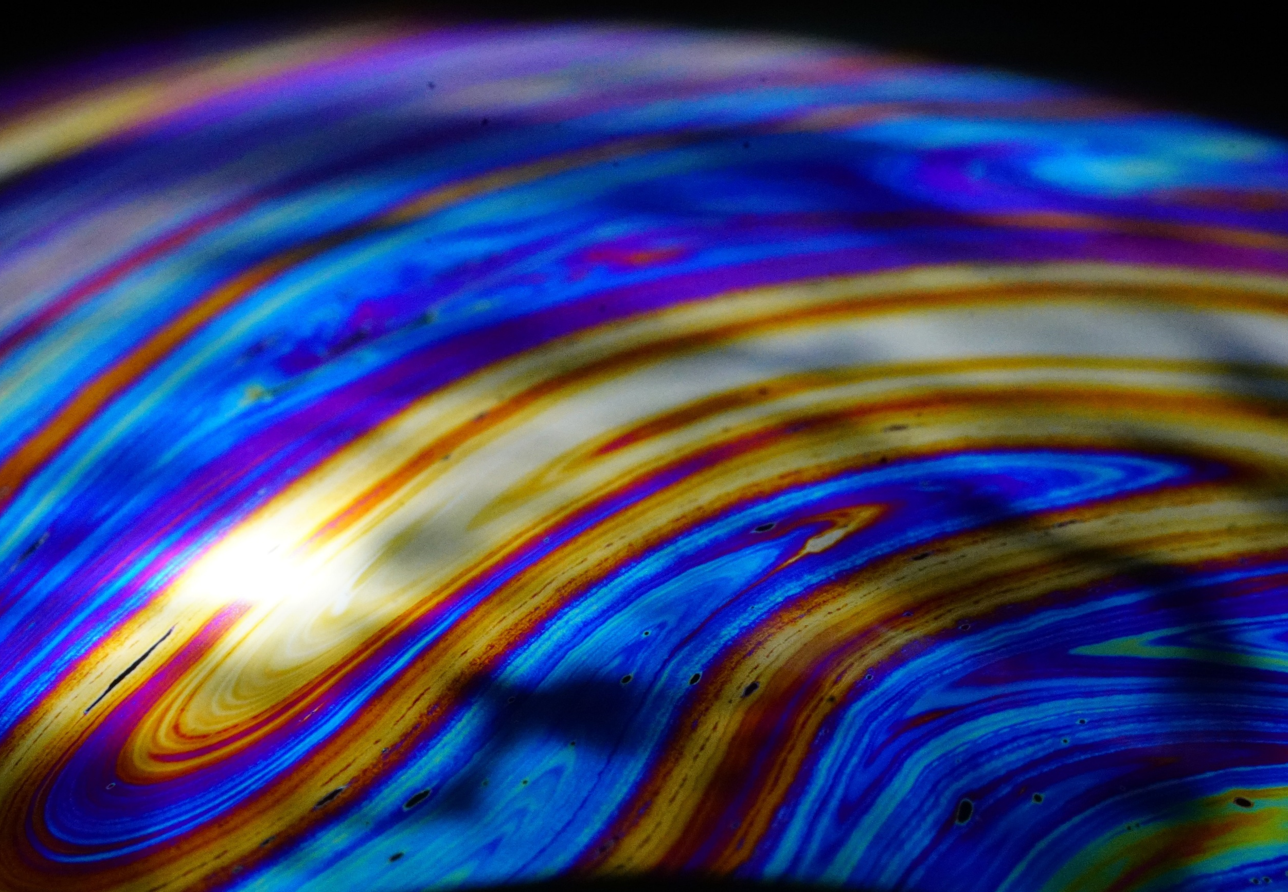
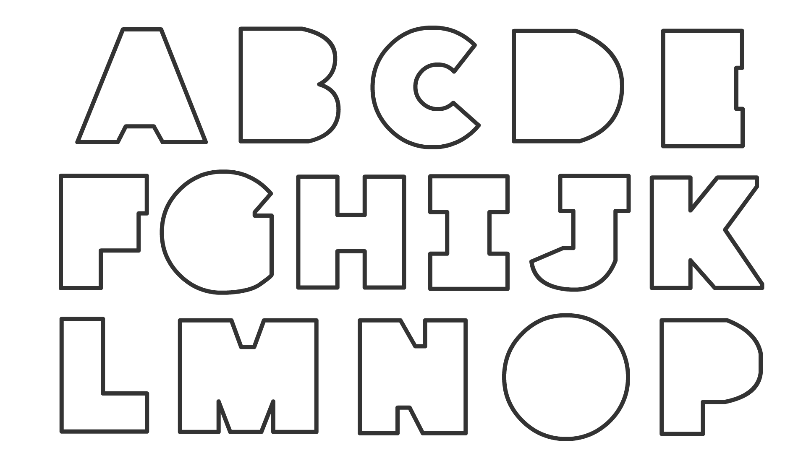
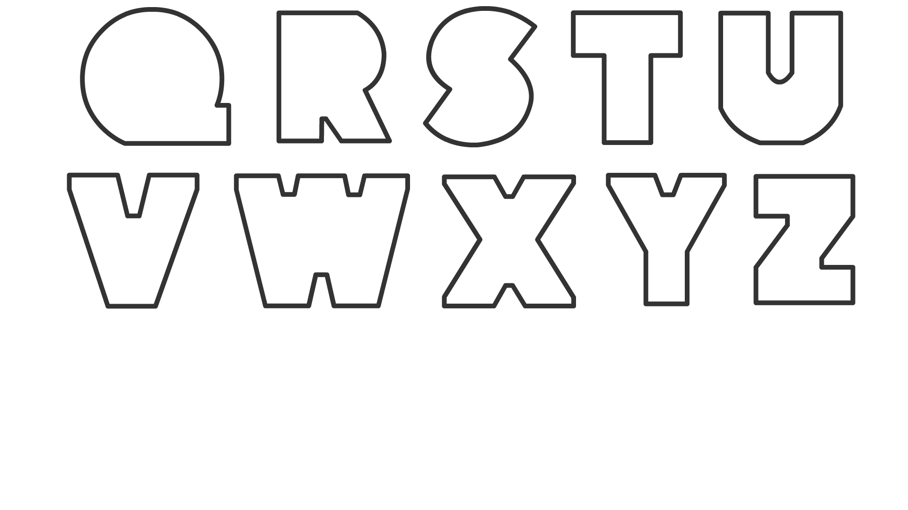
Notes:
To be printed in A4. PRINT INSTRUCTIONS:
Click “Print”
Click on the drop-down menu “Full page slides”
Uncheck “Scale to fit paper”

Slide 2


Slide 3


Slide 4


Slide 5


Slide 6


